Slide 1
Customer Churn Prediction
IST 718 - Big Data Analytics
By Group 23:
Daniel Joseph Eaton
Pranav Addipalli
Prateek Kumar Kumbar
Vinit Horakeri

Slide 2
Customer Churn - Overview
Customer churn, or attrition, is the rate at which clients opt out of purchasing more of a company’s products or services. Customer churn analysis is a method of measuring this rate.
Analysis of users’ event data and customer churn prediction for a music streaming service using PySpark and SparkML libraries.

Slide 3
Inference and Prediction
Inference: Manipulate large dataset to find out relationship between different attributes of website log data (artist, length, gender, level, interaction etc.) and the the target variable i.e., Churn.
Prediction: Using a machine learning model to make prediction about churn beforehand.

Slide 4
Data Exploration
Dataset: Music Streaming Data
Shape: 286500 x 18
Fields: artist, auth, firstName, gender, itemInSession, lastName, Length, Level, Location, Method, Page, Registration, sessionId, Song, Status, Ts, userAgent, userId
Categorical variables: 11, Numerical variables: 7
Missing values: 10 columns (7 - 8346 and 3 - 58392)

Slide 5
Conversion of web log data to user log data
User Information: churn, gender, level, and locCity
User activity: Partition by userID and aggregation to generate:
lifeTime
playTime
numSongs
numArtists
numPage

Slide 6
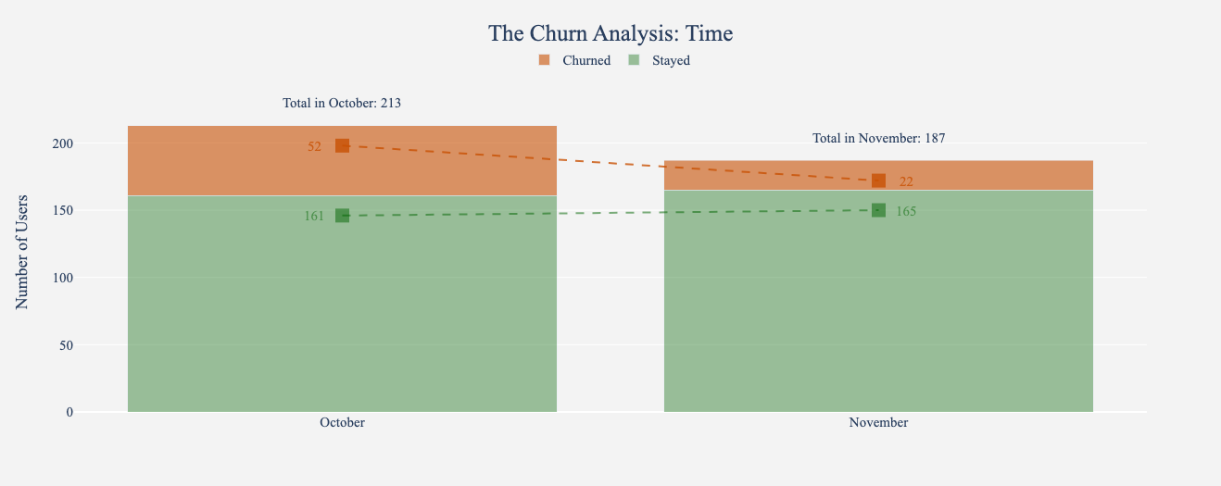
Findings
Churn Analysis: Time

Slide 7
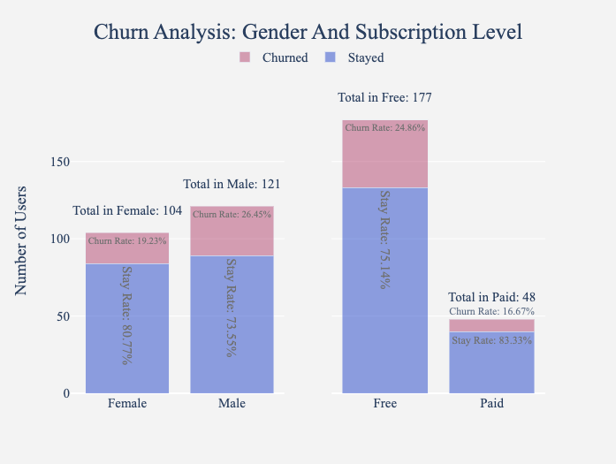
The Churn Analysis: Gender and Subscription Level

Slide 8
Feature Engineering
target - created from the Page column ( If Page = Cancellation Confirmation then target = 1 else 0)
artist_count - artist count per userId
gender
length - total length of songs listened by the user in seconds
thumb_up - total number of upvotes given by a user
thumb_down - total number of downvotes given by a user
level - level of user subscription (free, paid)
songs_count - the number of songs played by a user

Slide 9
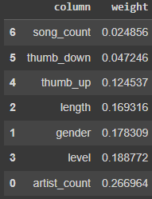
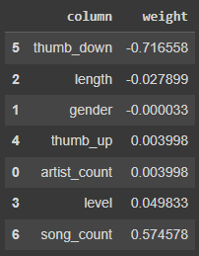
Classification Models
Logistic Regression
Explanatory variables: “artist_count”, “length”, “thumb up”, “thumb down”, “song_count”, “gender”, and “level”
Target Variable: Target(1 or 0 depending if the subscription was cancelled)
F1 score: 0.55
Random Forest
Same explanatory variables and target variable as logistic regression
F1 score: 0.62

Slide 10
Hyper Parameter Tuning
Hyper Parameter Tuning is done to improve f1 scores of models.
Hyper Parameter Tuning Steps:
Create a cross-validation model
Perform GridSearch
Re-train the model with grid search
Check for f1 score

Slide 11
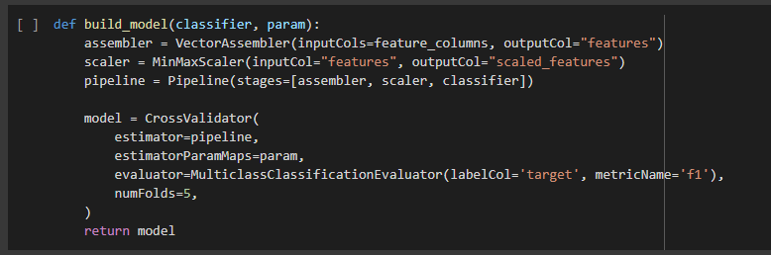
Hyper Parameter Tuning
Used k =5 folds cross validation model

Slide 12
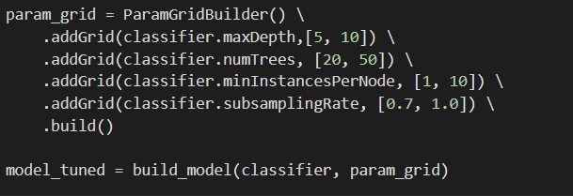
Hyper Parameter Tuning
GridSearch creates a grid of hyper-parameters with predefined values replacing the model suggested values.

Slide 13
Hyper Parameter Tuning
Improvement in f1 scores:
 | Before Tuning | After Tuning
LR f1 score | 0.55 | 0.69
RF f1 score | 0.62 | 0.72

Slide 14
Results Summary
Visualized time, gender and subscription level user level data.
83% of paid customers are not churned compared to free tier customers and female churn rate is less compared to male.
The top features according to Random Forest model are “Thumb_up, Thumb_down and artist_code”
Improved f1 scores for both Linear Regression and Random Forest after hyper-parameter tuning

Slide 15
Problems Encountered
Handling large amount of Data
Understanding web log data
Data Imbalance
Tuning a random forest model with grid search led to long run times for models.

Slide 16
Summary
Explored data for insights and unwanted values
Visually analysed churn rate based on Time, Gender and Subscription levels
Analysed user data for inferences about user-data
Performed feature engineering on multiple features
Built Linear Regression and Random Forest models
Tuned the model with GridSearch to improve f1 score

Slide 17
Contribution
Vinit Horakeri: Feature Engineering, Feature selection
Prateek Kumar Kumbar: EDA, Data Cleaning, Visualizations
Daniel Joseph Eaton: Model Building, Performance metrics
Pranav Addipalli: Hyper Parameter Tuning, Measuring accuracies

Slide 18
Questions?
Thank You

